Slide 1


AutoGuardian
A project by:
Ayoub Imad
Giacomo Reggianini
Matteo Lauriola

Slide 2

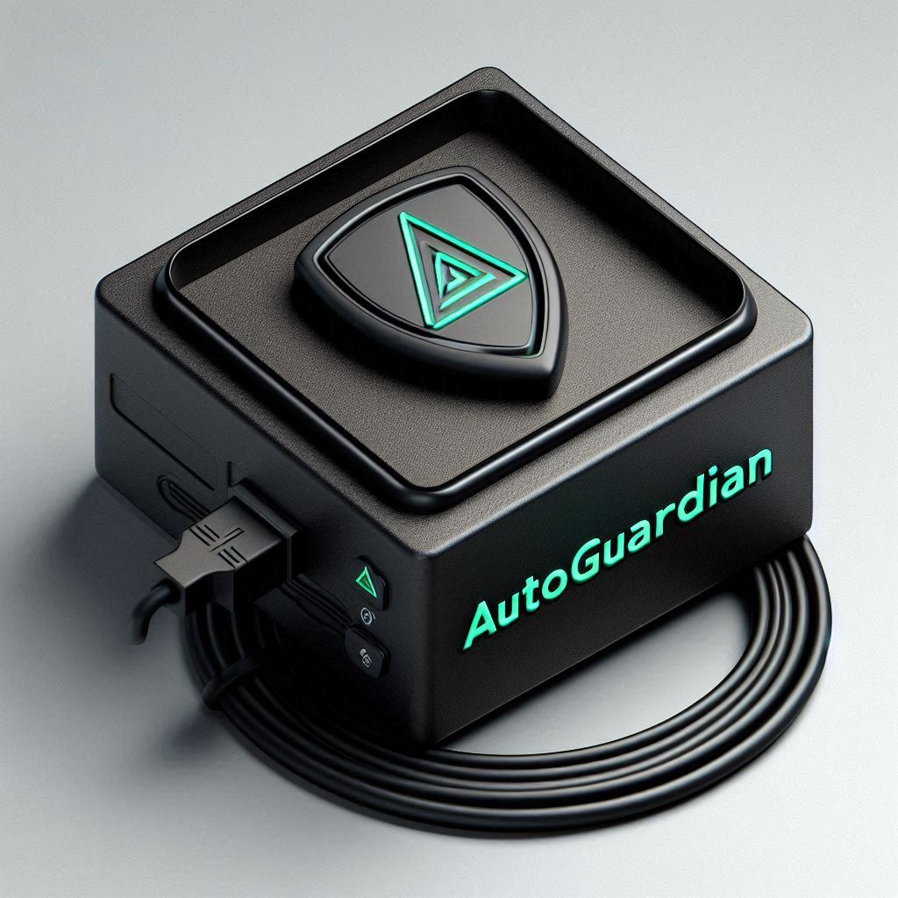
What is AutoGuardian?
AutoGuardian is an innovative device designed to be installed in your vehicle, capable of predicting fires, malfunctions, or accidents after they occur.
Once an incident is detected, AutoGuardian automatically contacts your emergency contacts and other nearby AutoGuardian devices within a small radius of kilometers, ensuring swift assistance and potentially preventing further damage or injury.

Slide 3
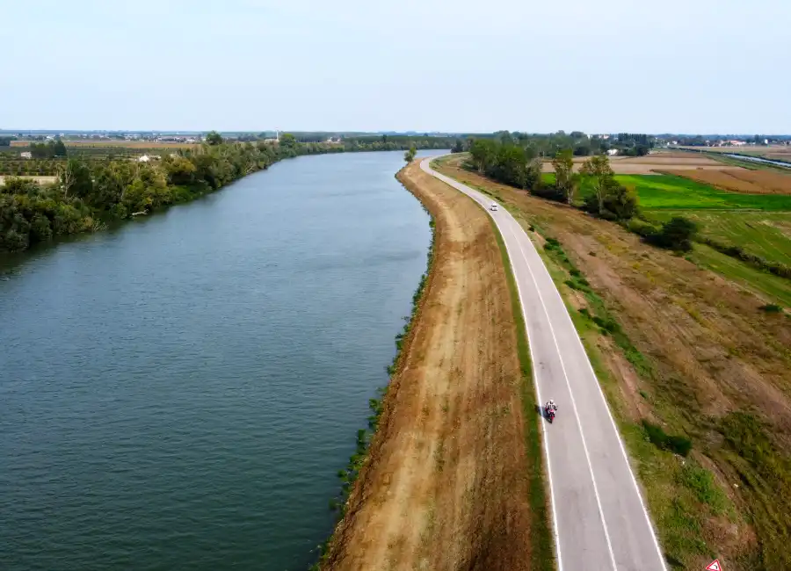
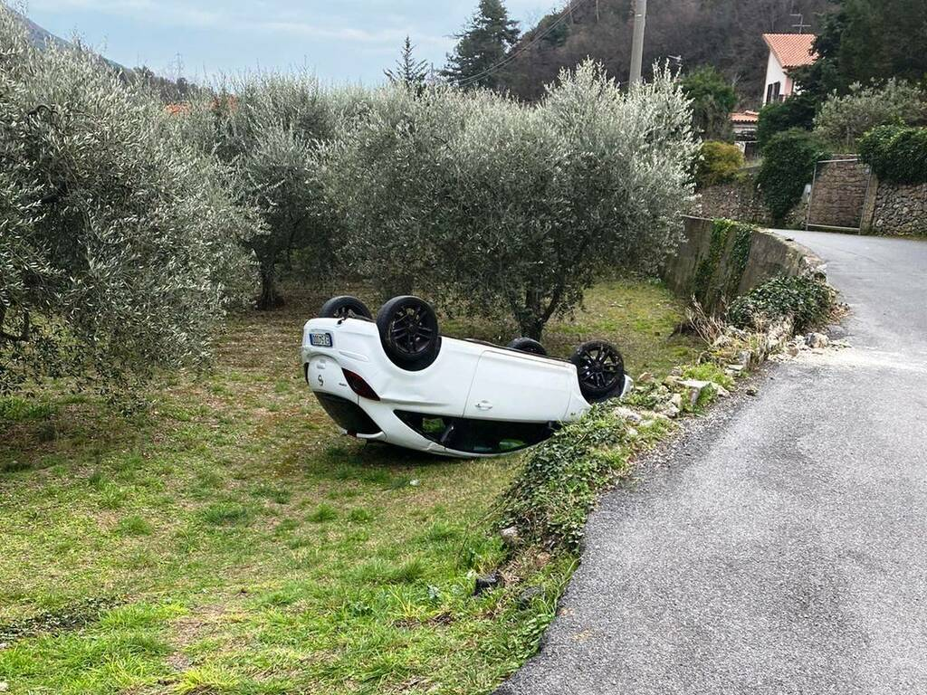
Why AutoGuardian?
In remote or less-traveled areas, accidents can go unnoticed for extended periods, leading to delayed response times and increased risks.
AutoGuardian provides real-time incident detection and monitoring, ensuring that help arrives swiftly when needed,
even in less-populated areas.
With AutoGuardian, you can drive with confidence,
knowing that you're never alone on the road."

Slide 4


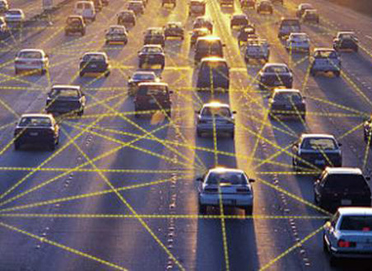
Features
Collection of various
type of data
Data prediction through AI
Communication between
all connected devices

Slide 5
Website

Slide 6
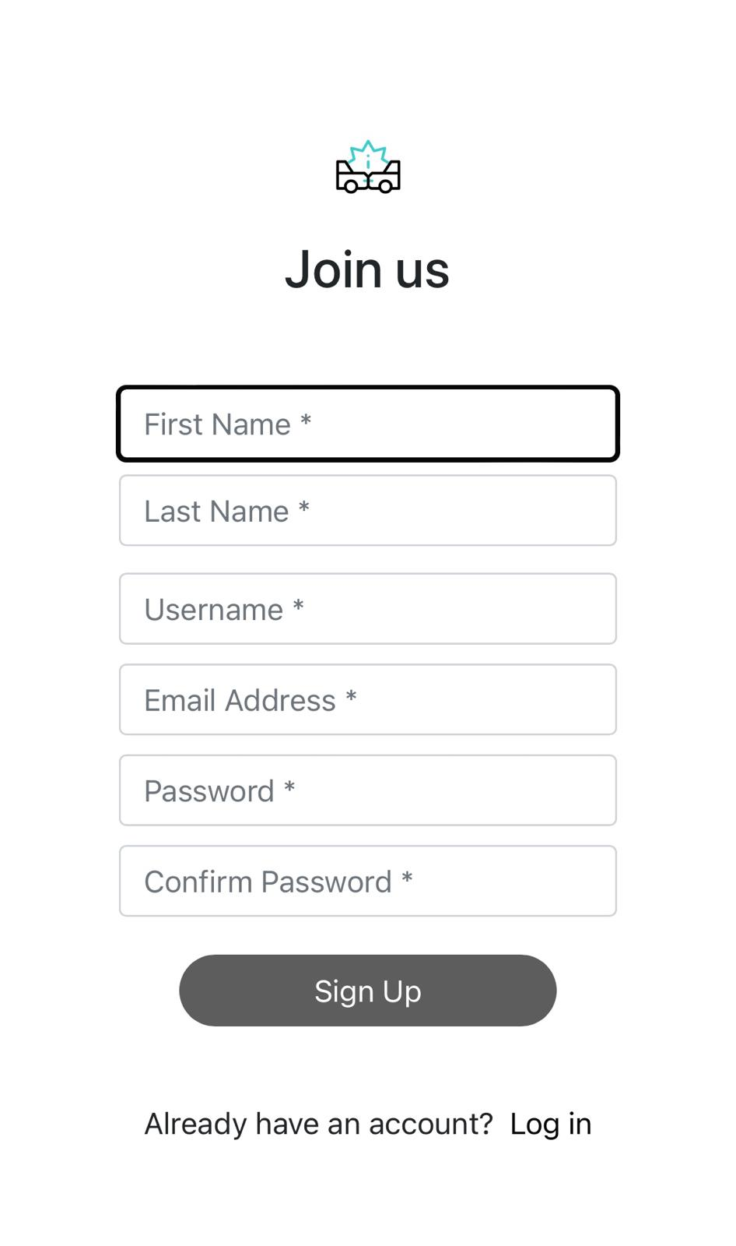
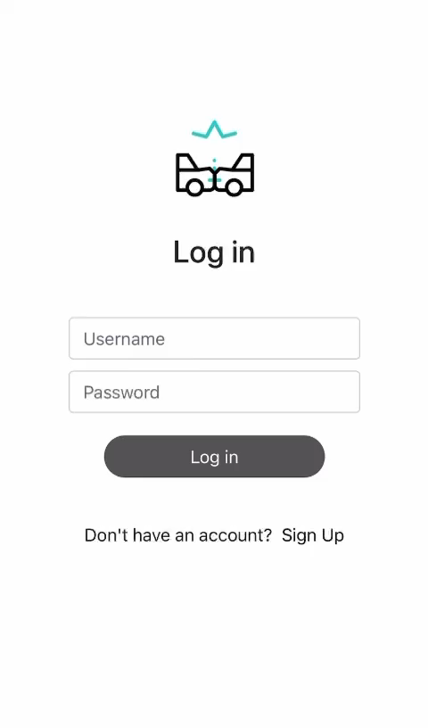
Registration Page
Once a client buy an AutoGuardian, it then have to register into our website and login with his credentials.

Slide 7
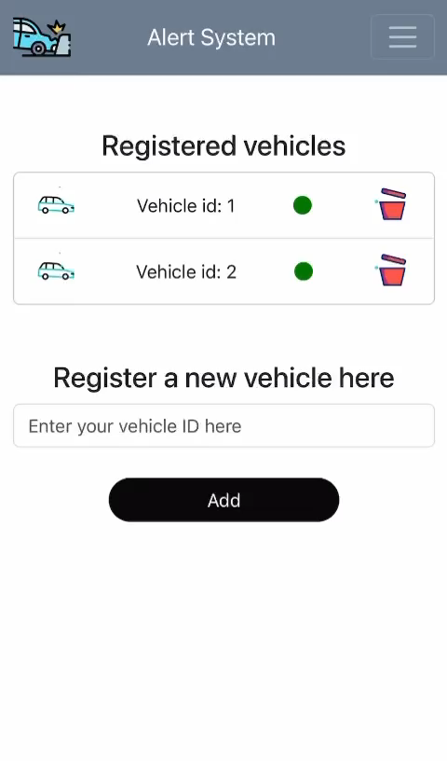
Registering Vehicles
Every AutoGuardian is univocally identified by a pass code (ID)
attached on his back.
The client can add or remove new vehicles whenever he want
He can also see the status of every device he own:
Vehicle correctly connected
Vehicle not connected

Slide 8
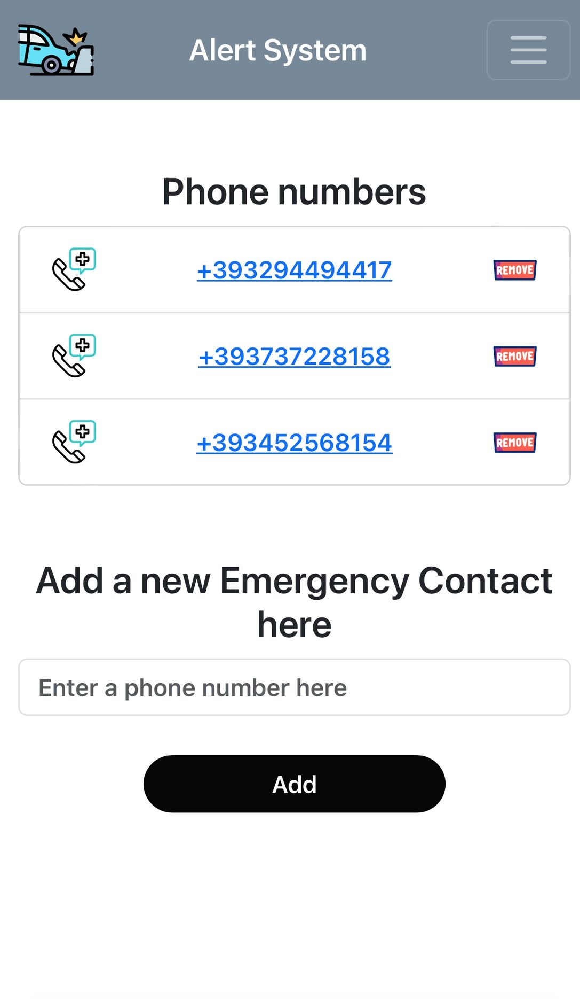
Add Emergency Contacts
There’s a dedicated page where the client can add or remove emergency contact’s numbers.
Every number in the list will be notified with a message in case of crash.

Slide 9
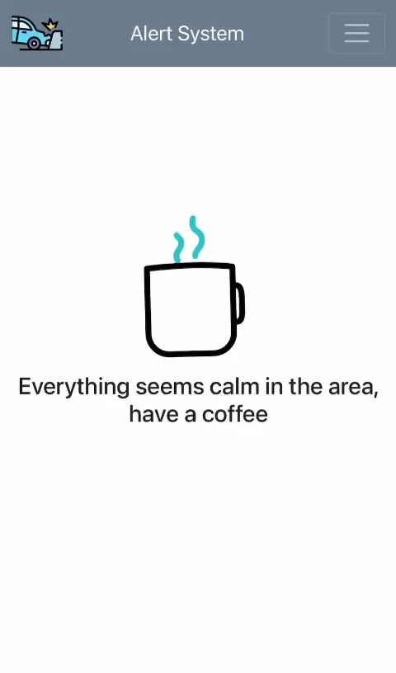
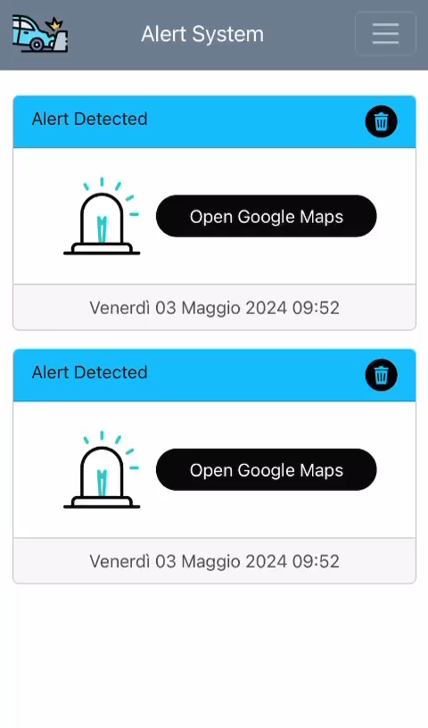
Alarm Page

Slide 10

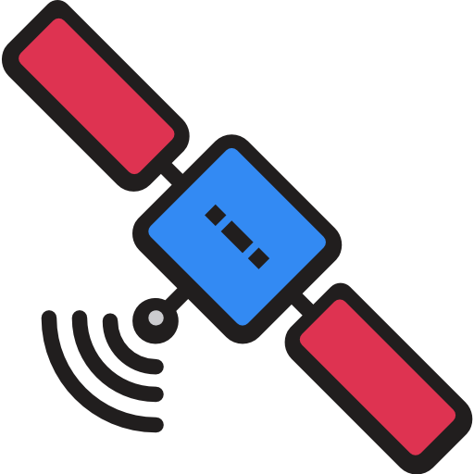




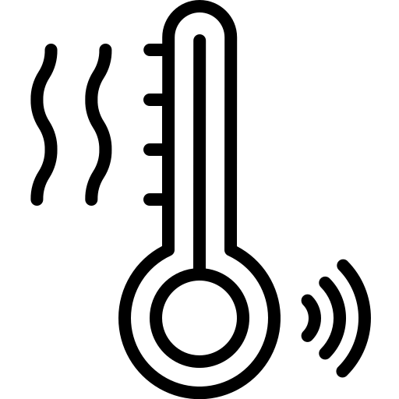
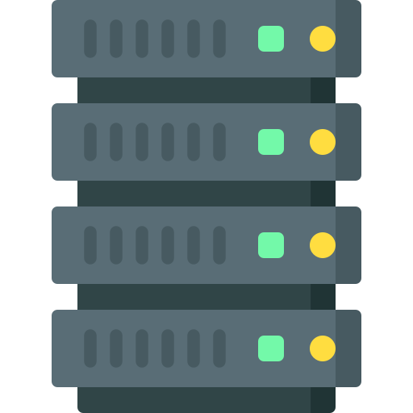



High Level Architecture
MQTT Broker
Vehicle
MCU
Bridge
Web Application
Web Server
Sensors/Actuators
Database
Predictor

Slide 11
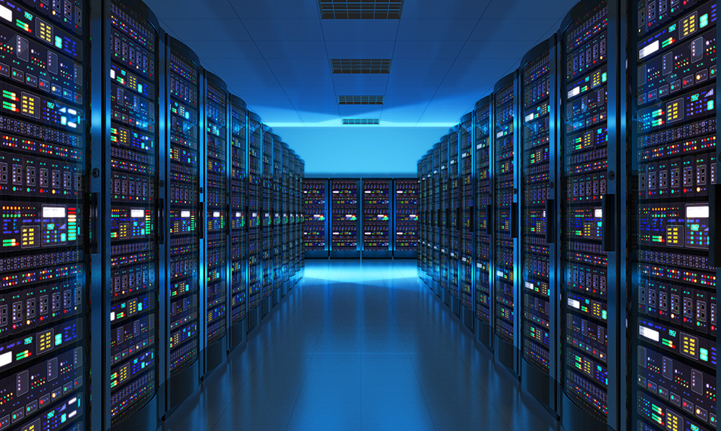
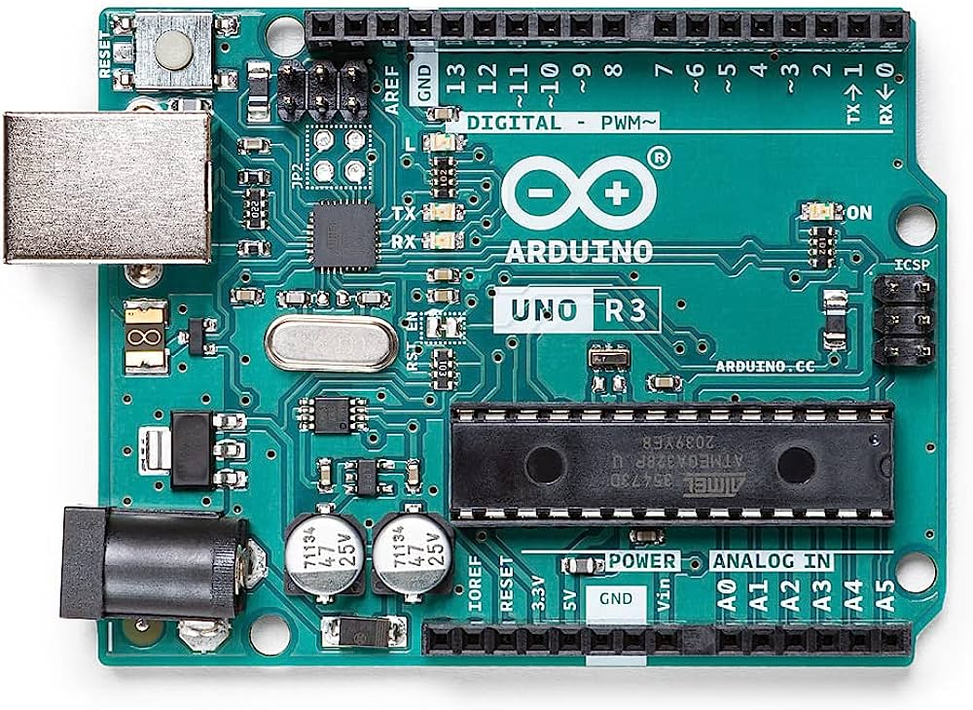
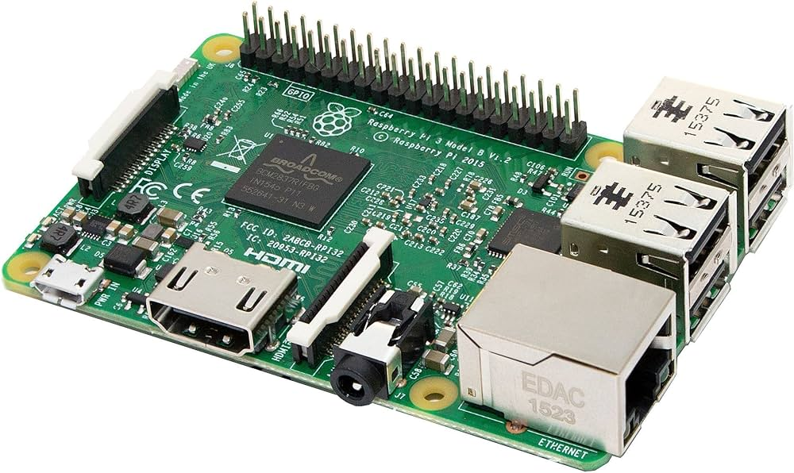
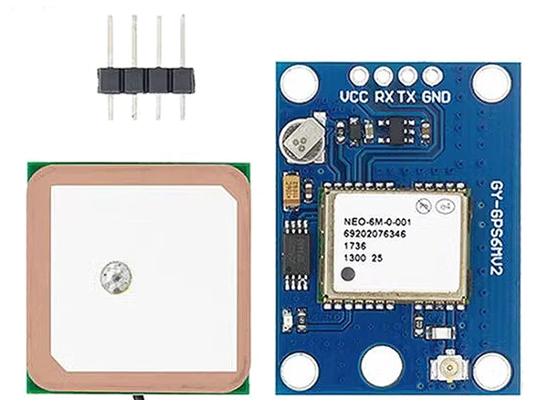
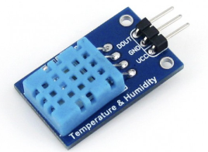
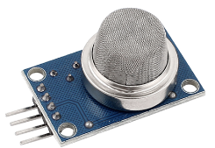
Components
Server
Arduino UNO R3
GPS Module GY-NEO6MV2
DHT11 Temperature Humidity Sensor
MQ2 Smoke
Raspberry (Bridge)

Slide 12
Sensors
GPS Module GY-NEO6MV2
receive and process signals from global positioning system (GPS) satellites
the module provides accurate(few meters) geographic coordinates
MQ2 Smoke sensor
detect the presence of flammable gases
produces an output signal that varies based on the concentration of the detected gas
DHT11 Temperature Humidity Sensor
digital device designed to measure air humidity and temperature every second

Slide 13
Devices
Arduino Uno
It is an electronic board equipped with a microcontroller that enables rapid prototyping
Raspberry Pi
The bridge manages:
The data read from the microcontroller
Packaging the data into JSON format for communication with the server.

Slide 14
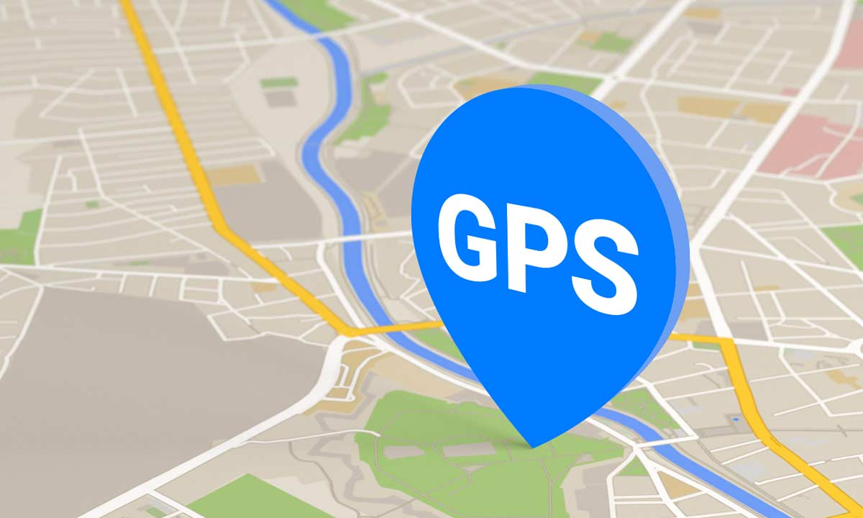

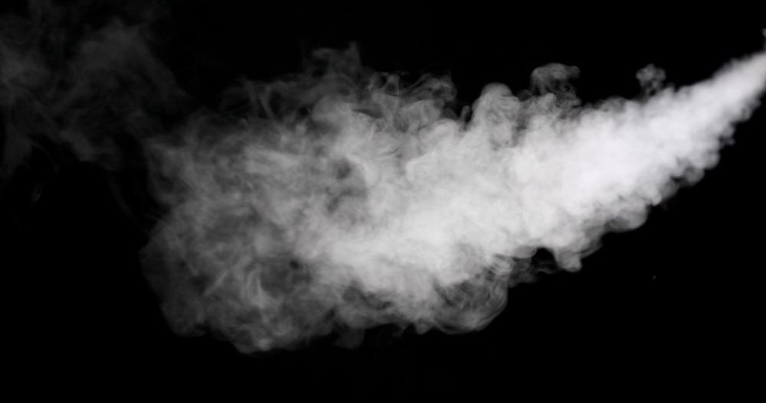
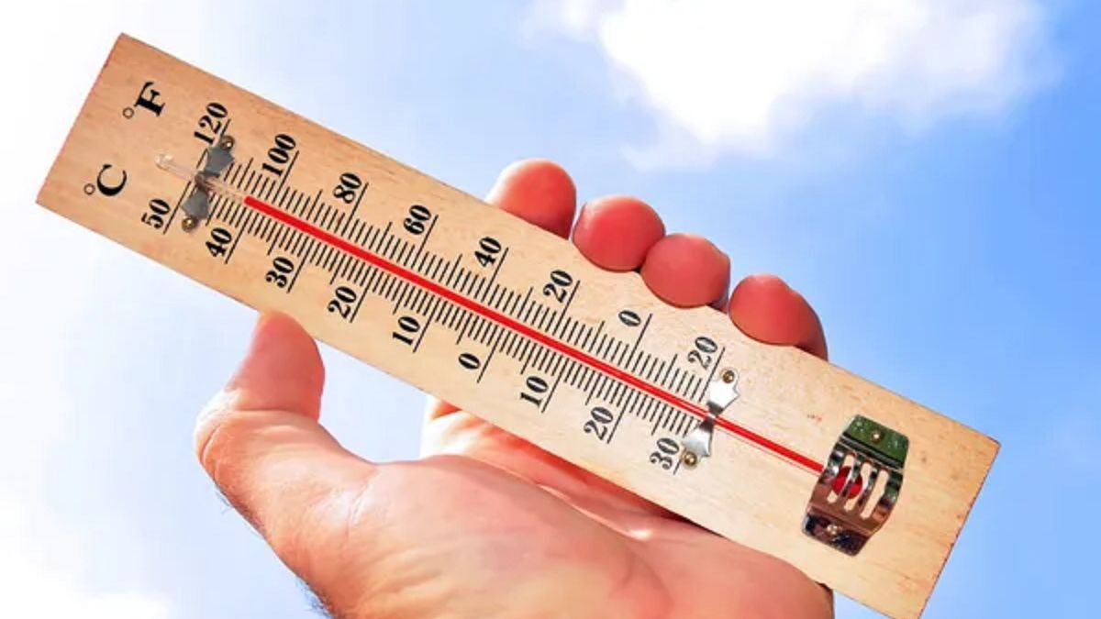
Data Type
Humidity, temperature, coordinates and smoke are
constantly detected by specific sensors.
Once the Arduino collects data higher than expected,
Everything is sent to the bridge
Moreover, the bridge ask periodically to the arduino to receive all the data,
so he can send it to the server where they are conserved.
This procedure is needed to:
Allow the call of the neighbor cars in case of emergency by another device
Evaluate the effective risk of an arduino alarm observing all the neighbor’s data

Slide 15
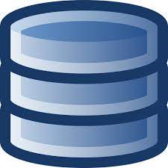
Data Collection
Once data are arrived in the server, they are stored in a DB.
The database conserve the metadata of each device:
ID
Longitude (last call)
Latitude (last call)
Humidity (last call)
Temperature (last call)
Smoke (last call)

Slide 16

Serial Diagram
Serial Communication

Slide 17
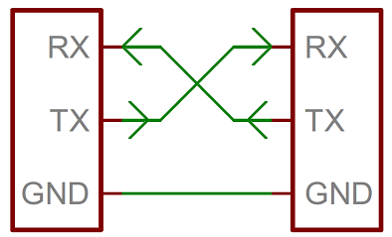
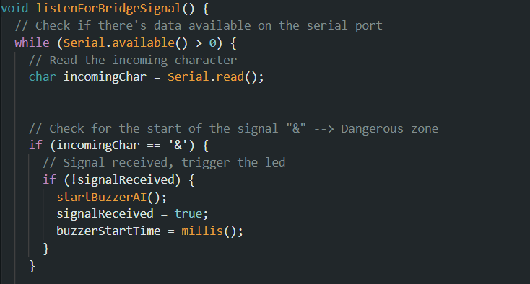
Serial Communication
Method of transferring data one bit at a time sequentially over a communication channel.
"Arduino and Raspberry Pi communicate via the UART (Universal Asynchronous Receiver-Transmitter) protocol, but they are not physically connected through the TX and RX pins.
Instead, communication occurs through the virtual serial channel, with Arduino sending data to the Raspberry Pi through the serial port, and the Raspberry Pi receiving and processing it."

Slide 18
HTTP Diagram
HTTP Communication

Slide 19

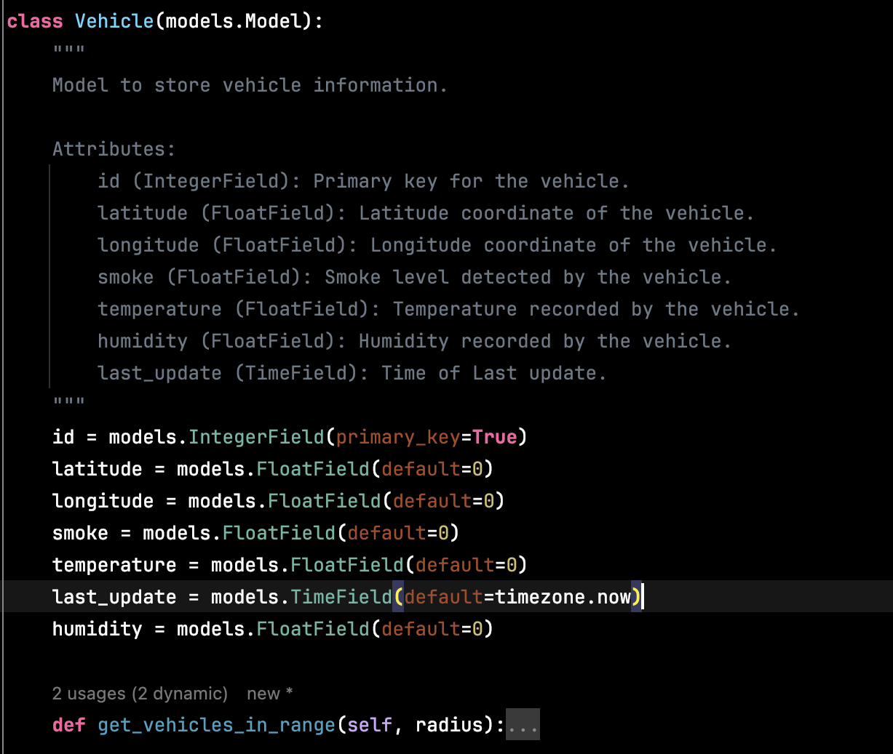
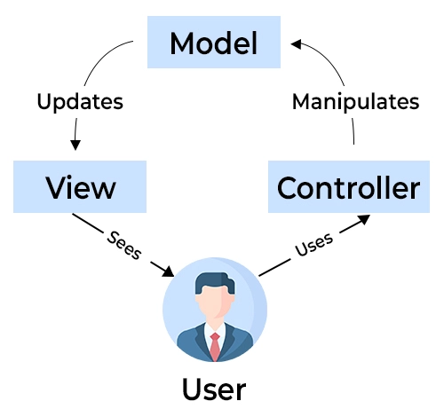
Web Server
Powered by Django framework
Don’t Repeat Yourself
Model-View-Controller Architecture
Object-Relational Mapping

Slide 20
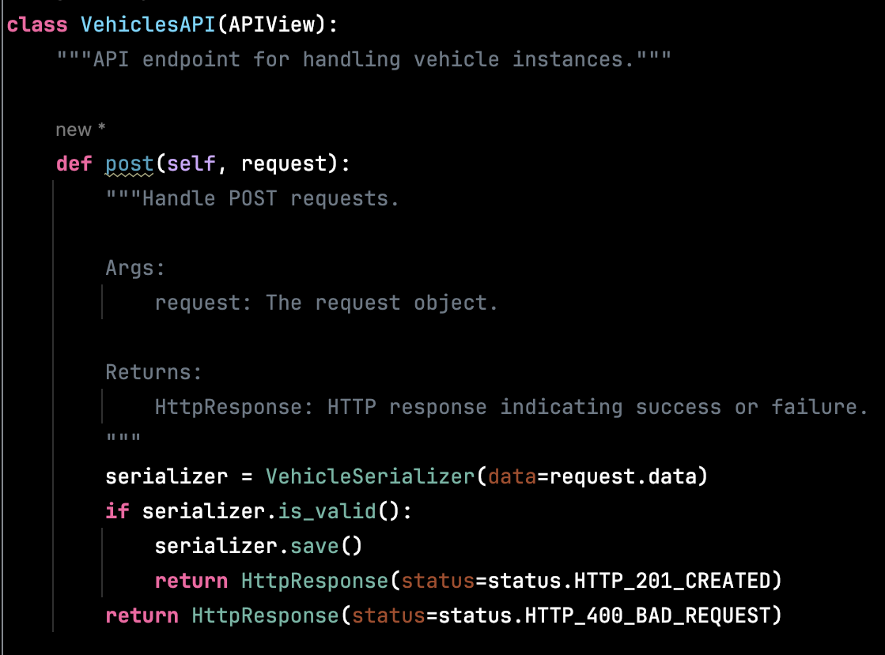
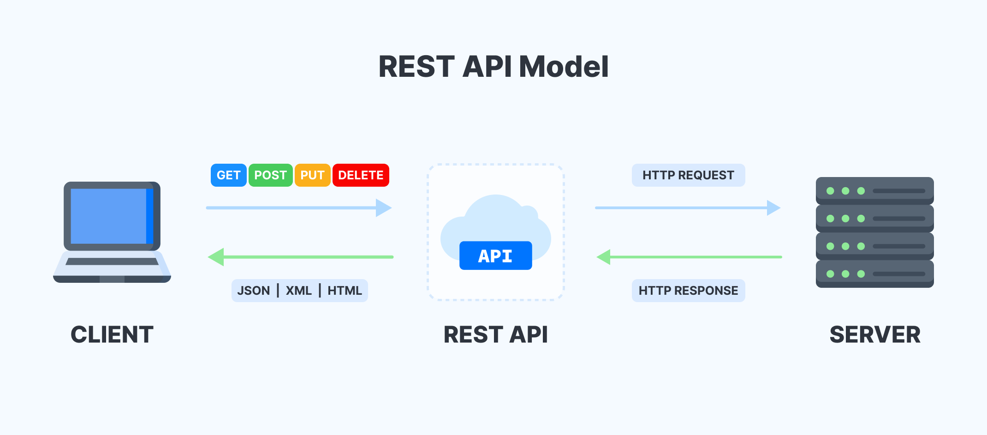

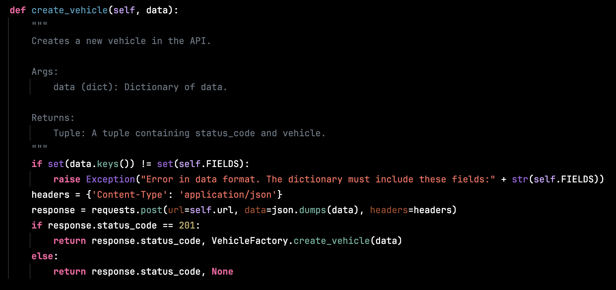



HTTP (API REST)
Server Side
Client Side
api/vehicle/{id}
Retrieve vehicle data
api/vehicle/{id}
Create new vehicle
api/vehicle/{id}
Update a vehicle
api/vehicle/{id}
Delete a vehicle

Slide 21

API REST Use Case
JSON
PUT api/vehicle/{id}
HTTP Response (200, 400)

Slide 22

MQTT Diagram
MQTT Communication

Slide 23
MQTT
MQTT (Message Queuing Telemetry Transport):
Low bandwidth and minimal battery loss
Broker-client communication model
Values sent during the connection :
clientID
Username & Password
Will Message
KeepAlive signal
CleanSession flag
Three types of QoS:
(0) At most Once
(1) At Least Once
(2) Exactly Once

Slide 24
MQTT Use Case
JSON
POST api/alert/
HTTP Response (201, 400)
Is it a real alert?

Slide 25
MQTT Use Case
MQTT Broker
Id:1
°
°
°
Who are the neighbors?
Id:N

Slide 26
Smart Alarm Check
Once an Arduino get a sensor value higher than a threshold:
it sends all his data to the bridge
The bridge send all the data to the server
Then, the server monitors all the neighbors of the calling device: if the average of all values among the neighbors and the calling device exceeds a certain threshold, then the alarm is considered true and action is taken; otherwise, the call is canceled.

Slide 27


Smart Check Diagram
{
$$\frac{1}{N}∗\sum_{k=1}^{N}{S_{k}}≤S_{1}+threshold$$
Take action
If
Alarm
Otherwise, cancel the call
$$S=Sensor value$$
$$\text{N}\text{ = }\text{number} \text{of} \text{neighbor}\text{s}\text{ + 1}$$
Alarm
Data
Data
Data
1
}
1’s Neighborhood
(range of 10 km from 1):
2
3
4

Slide 28

AI Predictions
What is it?
How does it work?
How did we use it?
Time Series Forecasting tool
Additive Model
Customizable
Exploratory Analysis
Additive Modeling
Parameter Estimation
Customization
Forecasting
Evaluation
Data Preparation
Creating and Training Prophet Models
Forecasting
Prediction

Slide 29
Thanks for your attention!

